Slide 2
Communications
Digital communications describes a process in which two or more computers or devices transfer data, instructions, and information
Sending device
Transmission media
Receiving device
Page 450

Slide 3
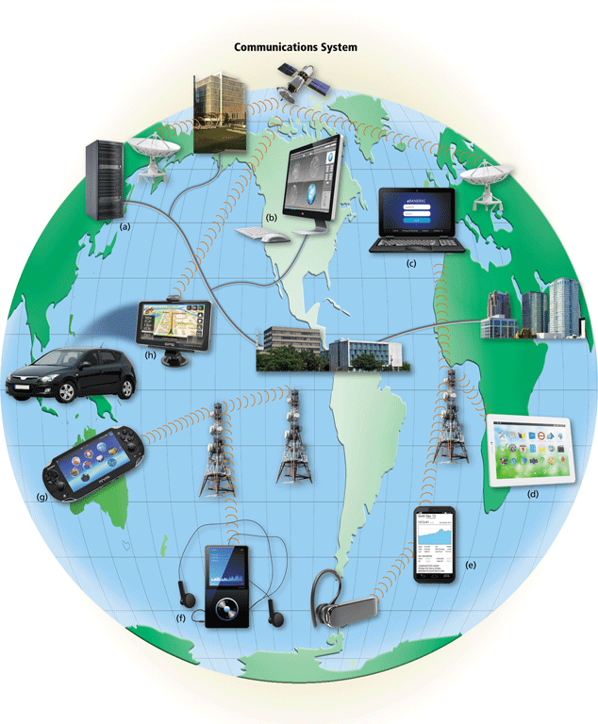
Communications
Page 451
Figure 10-1

Slide 4
Networks
A network is a collection of computers and devices connected together via communications devices and transmission media
Advantages of a network include:
Facilitating communications
Sharing hardware
Sharing data and information
Sharing software
Transferring funds
Pages 452 - 453

Slide 5
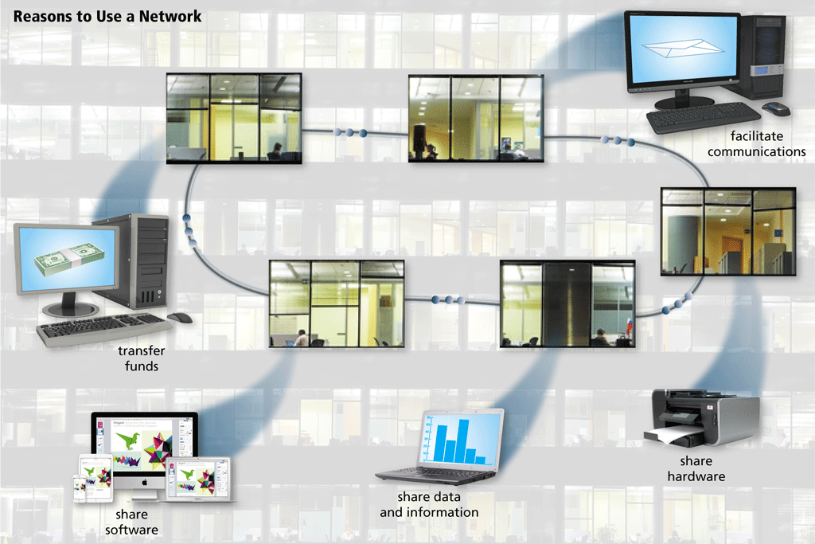
Networks
Page 452
Figure 10-2

Slide 6
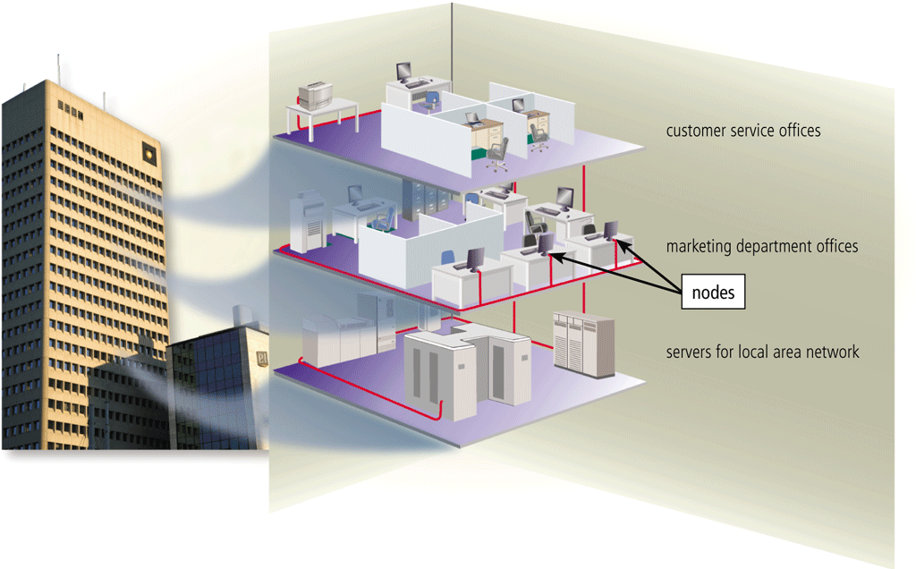
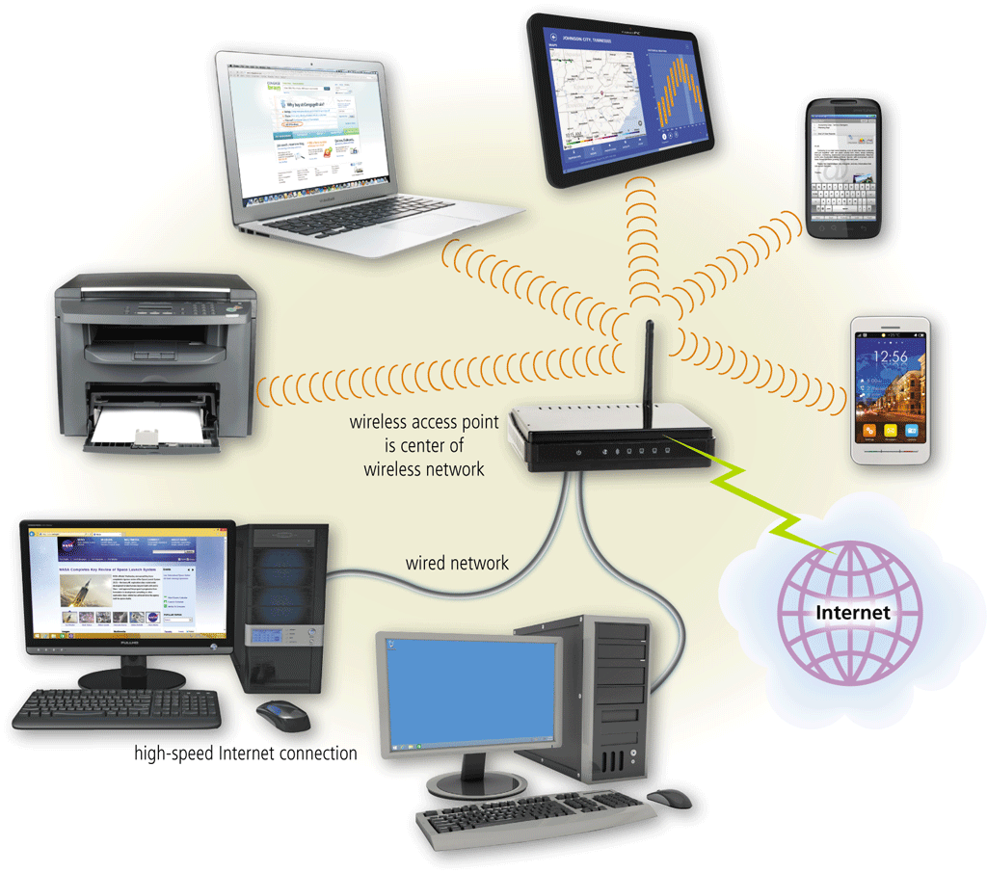
Types of Networks
A local area network (LAN) is a network that connects computers and devices in a limited geographical area
A wireless LAN (WLAN) is a LAN that uses no physical wires
Pages 453 - 454
Figures 10-3 – 10-4

Slide 7
Networks
A metropolitan area network (MAN) connects LANs in a metropolitan area. MANs span an entire geographic area typically a town or city, but sometimes a campus.
A wide area network (WAN) is a network that covers a large geographic area. The size of the WAN is larger than LAN and MAN. A WAN can cover cities, country or even continent.
A personal area network (PAN) is a network that connects computers and devices in an individual’s workspace with wired and wireless technology
Page 455
Figure 10-5

Slide 8
Networks
Campus Area Network (CAN)
Larger than LANs, but smaller than metropolitan area networks. These types of networks are typically seen in universities and small businesses.
Storage-Area Network (SAN)
A dedicated high-speed network that connects shared pools of storage devices to several servers. SANs can be accessed in the same fashion as a drive attached to a server
Page 455
Figure 10-5

Slide 9
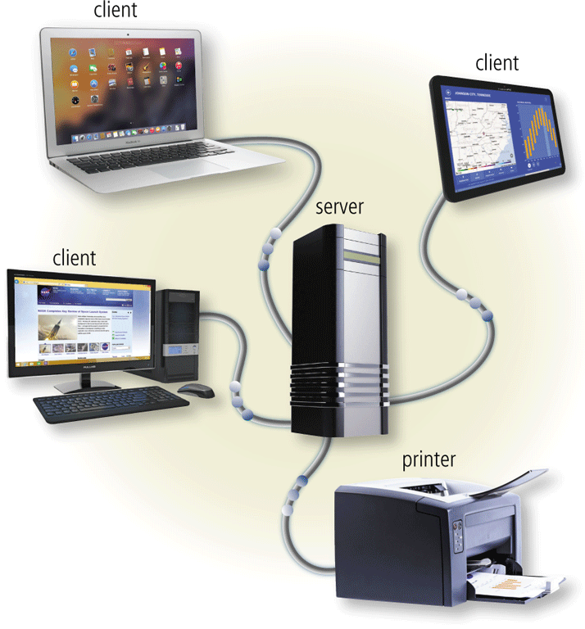
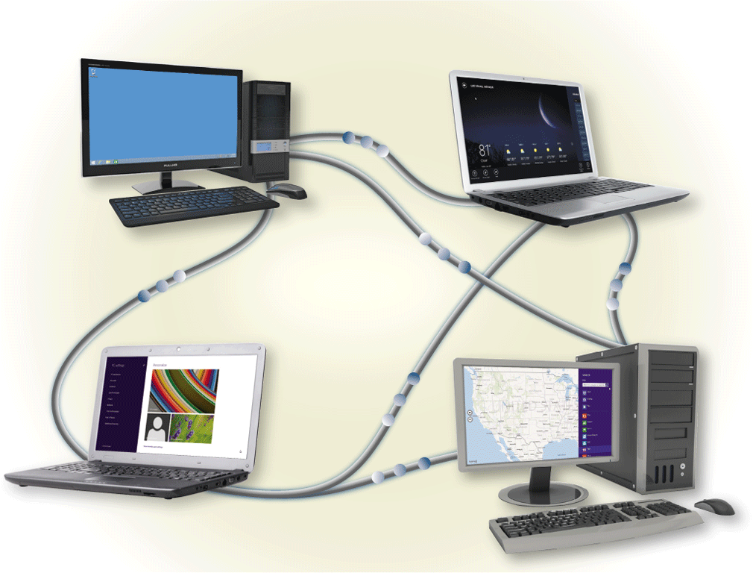
Network Architecture
The configuration of computers, devices, and media on a network is sometimes called the network architecture
Client/server network
Peer-to-peer network
Pages 456 - 457
Figures 10-6 – 10-7

Slide 10
Communications Devices
A communications device is any type of hardware capable of transmitting data, instructions, and information between a sending device and a receiving device
DSL modem
Cable modem
Page 468

Slide 11
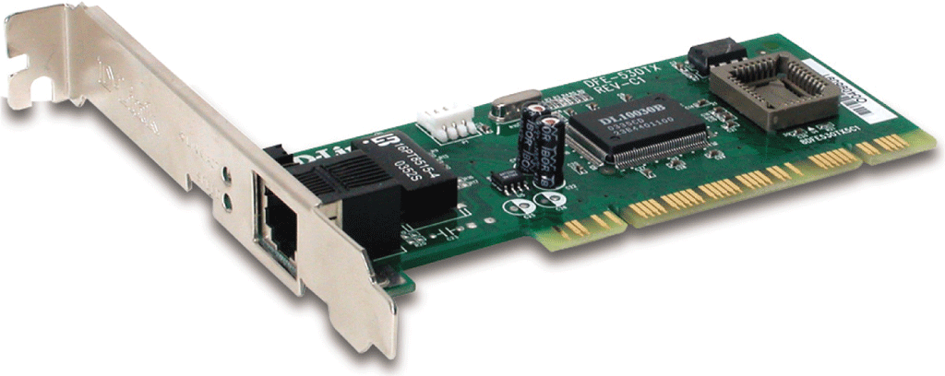
Network Interface Card (NIC)
A network card enables a computer or device that does not have built-in networking capability to access a network
Available in a variety of styles
Pages 472 - 473
Figure 10-17

Slide 12
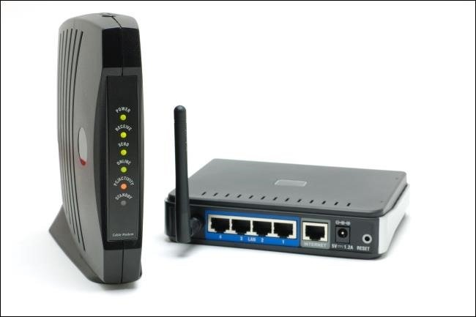
Modem
Modem is short for "Modulator-Demodulator."
Allows a computer to connect to the Internet.
it converts digital data from a computer or other device into an analog signal that can be sent over standard telephone lines.
Similarly, It converts an analog signal from a telephone or cable wire to digital data (1s and 0s) that a computer can recognize.
Pages 468 - 469

Slide 13
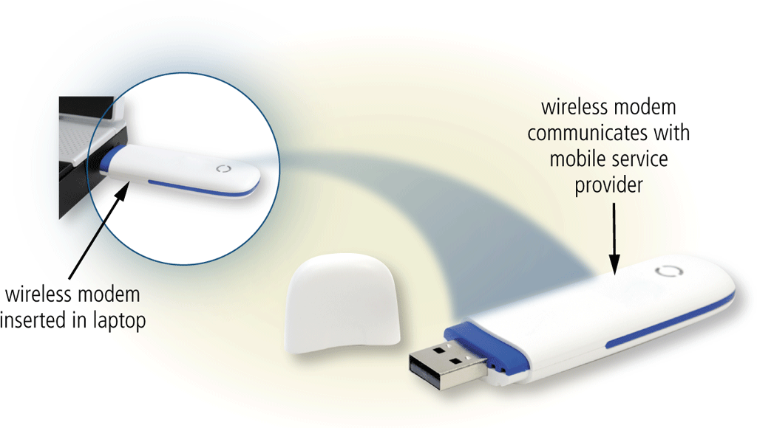
Wireless Modem
A wireless modem uses a mobile phone provider’s network to connect to the Internet wirelessly from a computer or mobile device
Page 469
Figure 10-13

Slide 14
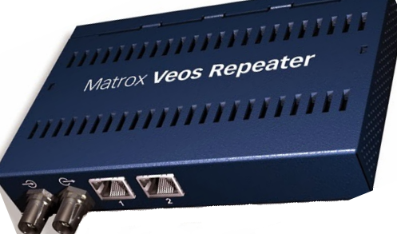
Repeaters
A network device used to regenerate or replicate a signal.
Repeaters are used in transmission systems to regenerate analog or digital signals distorted by transmission loss.
Analog repeaters frequently can only amplify the signal while digital repeaters can reconstruct a signal to near its original quality.
Repeaters work at the OSI physical layer to regenerate the network’s signal and resend them to other segments.
Page 470
Figure 10-14

Slide 15
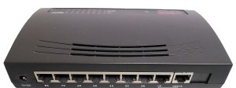
Hub
A hub, also called a network hub, is a common connection point for devices in a network.
Hubs are devices commonly used to connect segments of a LAN.
The hub contains multiple ports.
Broadcast: When a packet arrives at one port, it is copied to the other ports so that all segments of the LAN can see all packets.
Page 470
Figure 10-14

Slide 16
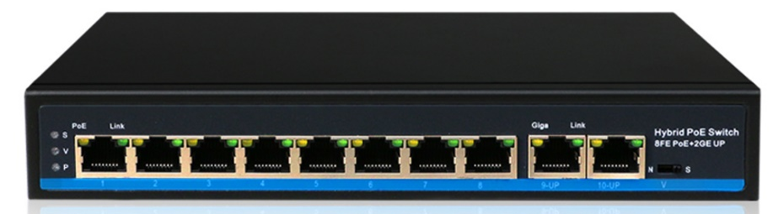
Switch
A network switch is networking hardware that connects devices by using packet switching to receive and forward data to the destination device.
Switches operate at the Data Link layer (layer 2) of the OSI model
Switches allow different nodes to communicate directly with one another in a smooth and efficient manner.
Page 470
Figure 10-14

Slide 17
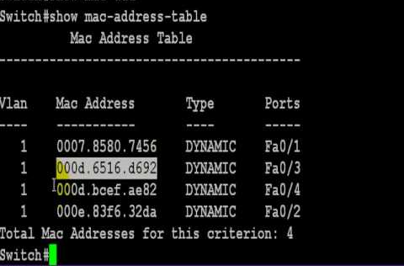
Switch
A network switch uses MAC addresses to forward data
Page 470
Figure 10-14

Slide 18
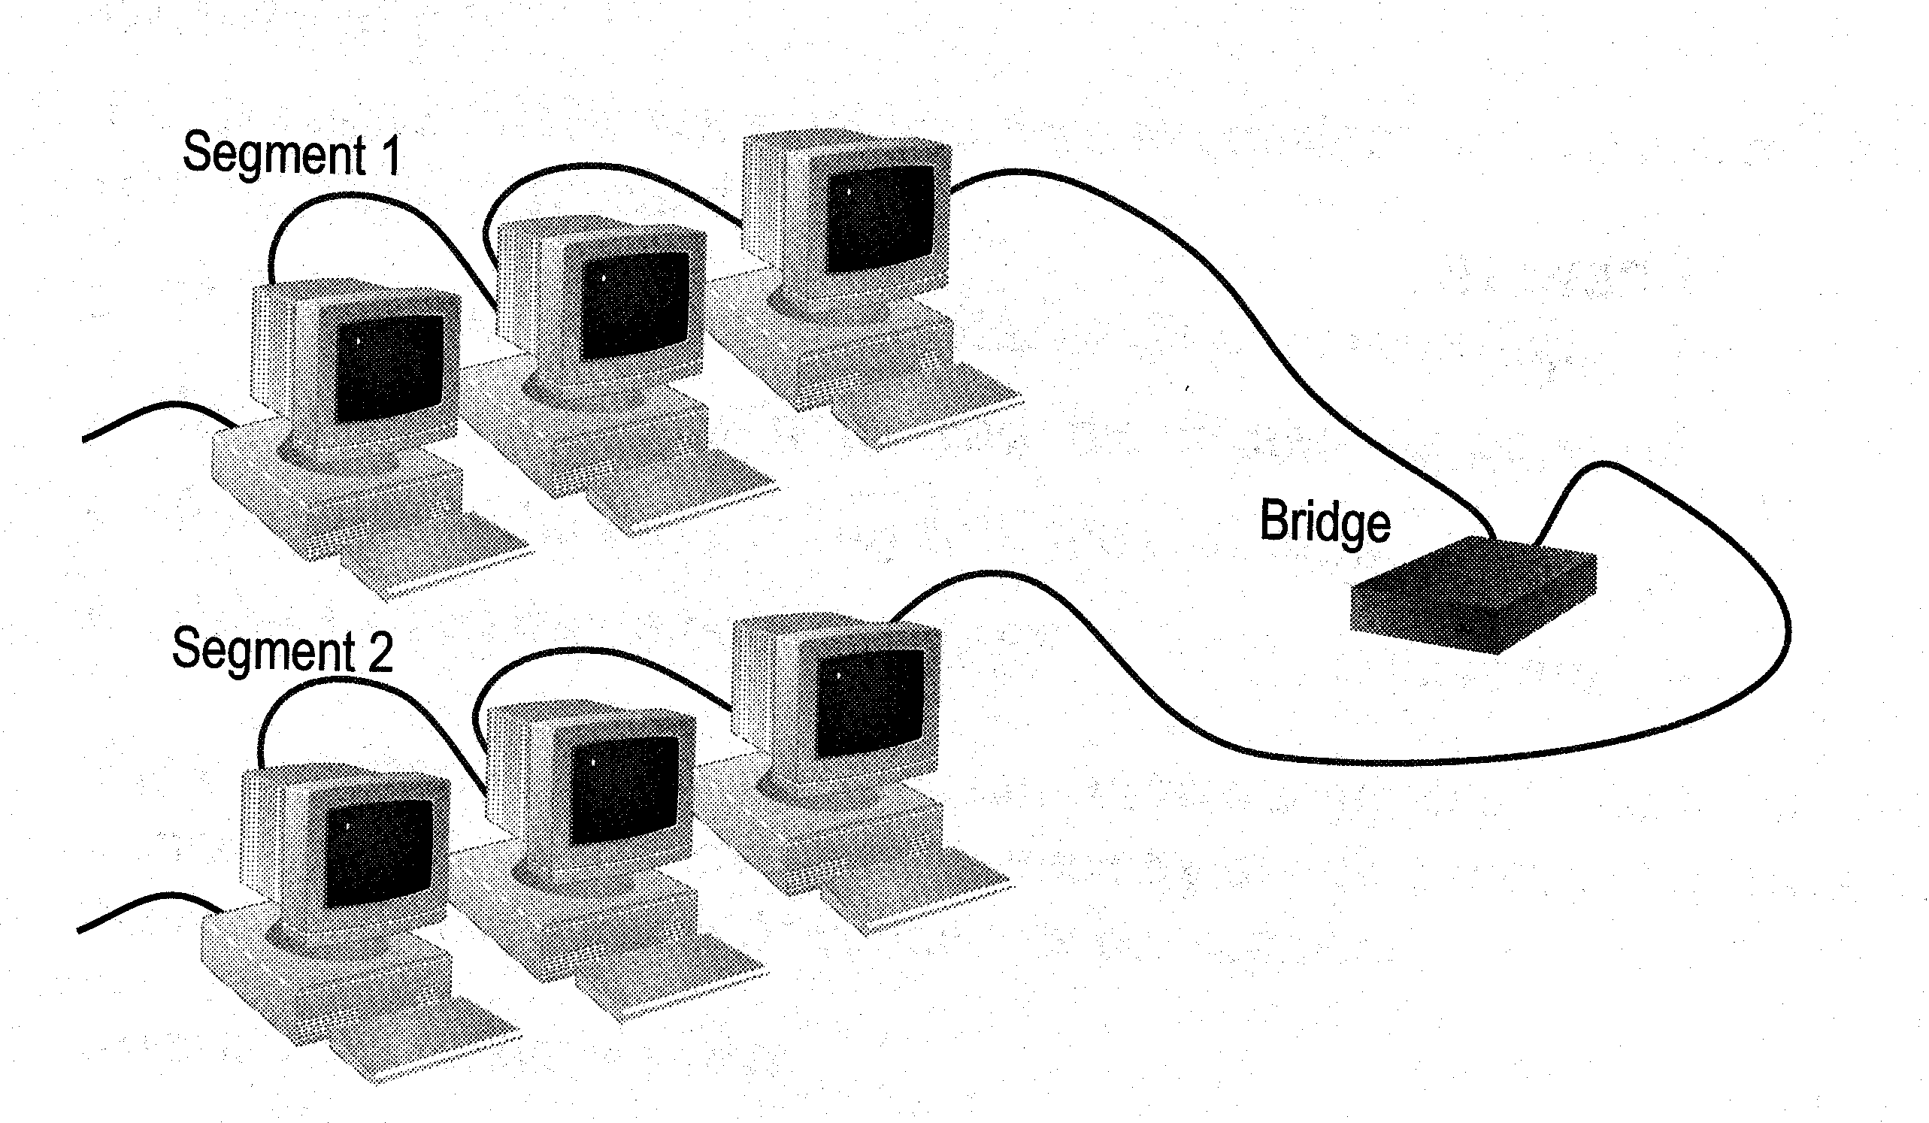
Bridge
Connects two local-area networks (LANs), or two segments of the same LAN that use the same protocol, such as Ethernet or Token-Ring.
Has one input and one output
Used to isolate network traffic and computers
Has the intelligent to examine incoming packet source and destination addresses
Page 470
Figure 10-14

Slide 19
Bridge
Bridges work at the Data Link Layer of the OSI model (2nd Layer)
Routing table is built to record the segment number of address
If destination address is in the same segment as the source address, stop transmit
Otherwise, forward to the other segment
Page 470
Figure 10-14

Slide 20
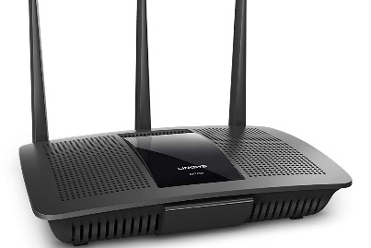
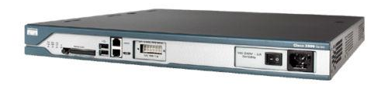
Router
A router connects two networks, commonly two LANs or WANs or a LAN and its ISP's network.
A router is a device that forwards data packets along networks.
Routers use headers and routing tables to determine the best path for forwarding the packets.
They use protocols such as ICMP to communicate with each other and configure the best route between any two hosts.
Page 470
Figure 10-14

Slide 21
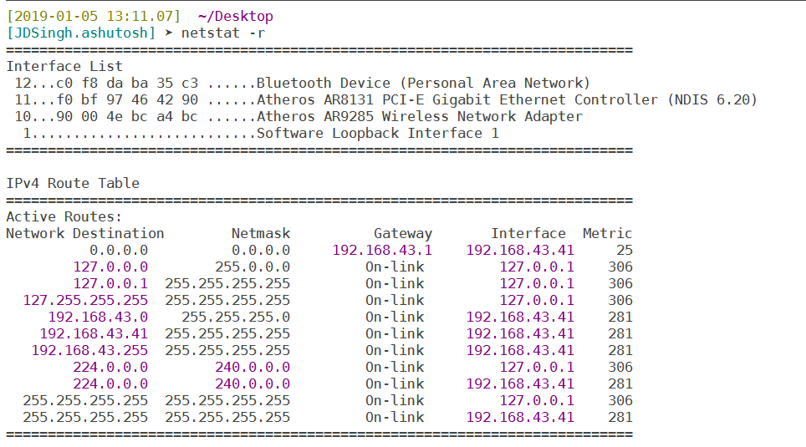
Router
Router works on IP addresses
Router uses Routing table for forward data to destination
Page 470
Figure 10-14

Slide 22
Thank You !

